Slide 1


Declare PV Independence before Aug 15

Slide 2

Your Success starts with YOU
Purchase once..get paid for 12 weeks!
Invest Rs.43389/-
Experience all Products
Get 600PV instead on 475PV
Stay Active for 12 weeks
No more purchases for 12 weeks for get income
25% Extra Team Bonus
By getting your downlines in this program, 12 weeks income is protected
Better consumption, Tasting Parties
Right Business Culture

Slide 3
Be a Part of the CCom Global Wellness Community
Make a Fortune by Staying Healthy and helping other to stay Healthy

Slide 4

Revitalize Yourself in 90 Days…

Slide 5
Total Wellness Experience in 90 Days
Improve your CELL health
Prevent Degeneration: Pump your body with Natural anti-oxidants to protect from Oxidation caused by pollution, stress, chemicals etc
Reverse Degeneration: Control your Blood Sugar level and Cholesterol levels
Experience Cardio Protective and Neuro Protective effects
Detoxification and Cellular level
Anti-aging: Grow younger in 90 days
Healthy way of Reducing Weight and losing Excess Fat
Regain the Body shape
Perform an very high energy levels and experience higher productivity at work

Slide 6
All at an Investment of Rs.43,389/-
Highest quality Protein
Anti-Oxidant Rich Juices
Resveratrol for Cardio and Neuro Protection
Immunity booster
Weight Management/Meal Replacement
Nutritional Energy Drink
Tasty wholesome nutrition meal
Wellness Trainings

Slide 7

Be a Social Entrepreneur by being part of the Wellness Community
Step 1 – Participate in growing this Global Wellness Community by introducing two people within a week.
Step 2 – Enjoy the Passive Income when the same process get duplicated

Slide 8
Earn Upto Rs.4,30,000 per week when you complete the 90 Days Health Challenge
On applying the Power of Two (a new person introduces two new referrals within a week) the community grows exponentially
On the 12th week there will be 4096 new people joining the community.
One Wellness Pack gives you 200PV in that week and 200PV each for the next two months.
In 12th week you will have 8,00,000+ PV
Even if your community is only 25% of this, you have 2Lakh PV in that week, 1Lakh PV on both sides.
Your Income will be Rs.4.30,000 in that week
The effect will be there for the next 12 weeks even if there is no more addition to the community after that

Slide 9
Be a Wellness Entrepreneur
Just do a 500 PPV
And run a ….
“WELLNESS CLUB”

Slide 10
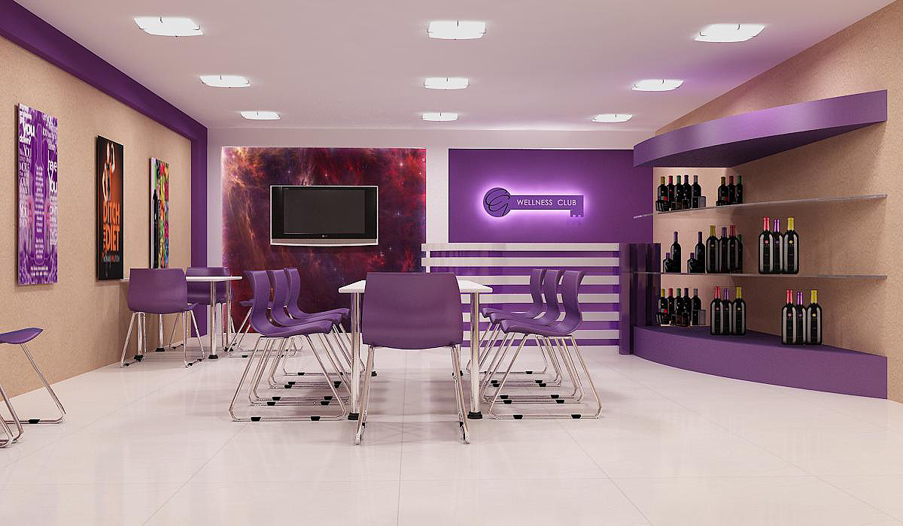
Be a Wellness Entrepreneur

Slide 11

benefits for the CWC Owner
You are getting an opportunity to step into the multi-trillion dollar wellness industry.
You will have people ‘walking in’ to your business that you ‘going out’ to them. A revolutionary model in Direct Selling
Participating in a Good Cause of Creating a Wellness Community. You are going to become an apostle of optimal health.
Can start with minimum investment, even from home
Strong backend support from CCom Resource Center. No need to invest extra money on designing packages and creating new recipes
You can leverage your business by helping more people to become Wellness Entrepreneur by starting their own Wellness Clubs. This will help you to make huge residual income.
You are becoming a Social Entrepreneur as the society is going to benefit when people maintain good health and hence their productivity in work goes up.

Slide 12

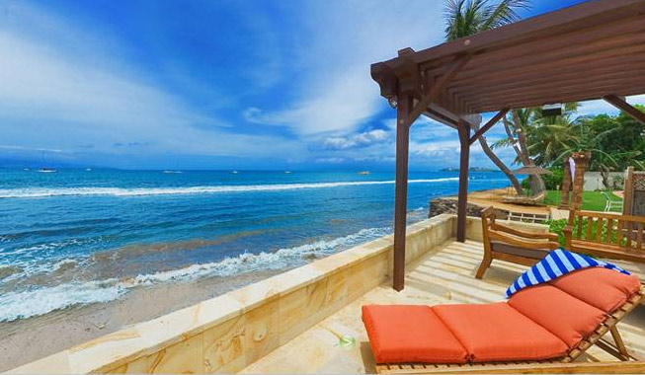
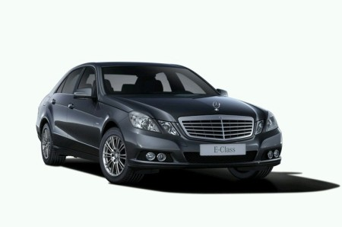

Live Your Dreams

Slide 13
CONSUMER TRACK
DO 200 PV (2 CASE)
Use world class wellness products

Slide 14
3 simple ways to join
1. Business Track (600PV), with wellness pack & there is no need to do pv for next 3 month. All business trainings will be for Business Track.
2. Wellness Club (1000PV) or Combo pack & 500PV, Special Trainings for Wellness Clubs.
3. Consumer Track (200PV), u can just use world class quality wellness products
Just focus on two and their two

